Slide 1




SRM INSTITUTE OF SCIENCE AND TECHNOLOGY,
CHENNAI.
18CSC205J-Operating Systems
Unit- IV

Slide 2
18CSC205J Operating Systems Unit IV
Course Learning Rationale
Emphasize the importance of Memory Management concepts of an Operating system
Course Learning Outcomes
Understand the need of Memory Management functions of an Operating system
Find the significance of Device management role of an Operating system
Realize the significance of Device Management part of an Operating system
Learning Resources
Abraham Silberschatz, Peter Baer Galvin, Greg Gagne, Operating systems, 9th ed., John Wiley & Sons, 2013
William Stallings, Operating Systems-Internals and Design Principles, 7th ed., Prentice Hall, 2012
Andrew S.Tanenbaum, Herbert Bos, Modern Operating systems, 4th ed., Pearson, 2015
Bryant O‟Hallaxn, Computer systems- A Programmer‟s Perspective, Pearson, 2015

Slide 3
Contents
Virtual Memory– Background
Understanding the need of demand Paging
Virtual Memory – Basic concepts – page fault handling
Understanding, how an OS handles the page faults
Performance of Demand paging
Understanding the relationship of effective access time and the page fault rate
Copy-on write,
Understanding the need for Copy-on write
Page replacement Mechanisms: FIFO, Optimal, LRU and LRU approximation Techniques
Understanding the Pros and cons of the page replacement techniques
Counting based page replacement and Page Buffering Algorithms
To know on additional Techniques available for page replacement strategies
Allocation of Frames - Global Vs. Local Allocation
Understanding the root cause of the Thrashing
Thrashing, Causes of Thrashing
Understanding the Thrashing
Working set Model
Understanding the working set model for controlling the Working set Model

Slide 4
Virtual Memory
Virtual memory is a technique that allows the execution of processes that are not completely in Main memory.
Virtual memory – involves the separation of logical memory as perceived by users from physical memory.
Need for virtual memory
Programs often have code to handle unusual error conditions. Since these errors seldom, if ever, occur in practice, this code is almost never executed.
Arrays, lists, and tables are often allocated more memory than they actually need. An array may be declared 100 by 100 elements, even though it is seldom larger than 10 by 10 elements.
An assembler symbol table may have room for 3,000 symbols, although the average program has less than 200 symbols. Certain options and features of a program may be used rarely. Even in those cases where the entire program is needed, it may not all be needed at the same time.

Slide 5
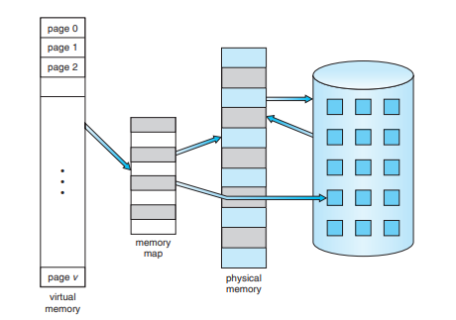
Virtual Memory
One major advantage of this scheme is that programs can be larger than physical memory.
Further, virtual memory abstracts main memory into an extremely large, uniform array of storage, separating logical memory as viewed by the user from physical memory.
This separation allows an extremely large virtual memory to be provided for programmers when only a smaller physical memory is available.
Virtual memory makes the task of programming much easier, because the programmer no longer needs to worry about the amount of physical memory available.
This technique frees programmers from the concerns of memory-storage limitations.
Virtual memory also allows processes to share files easily and to implement shared memory.
In addition, it provides an efficient mechanism for process creation.

Slide 6
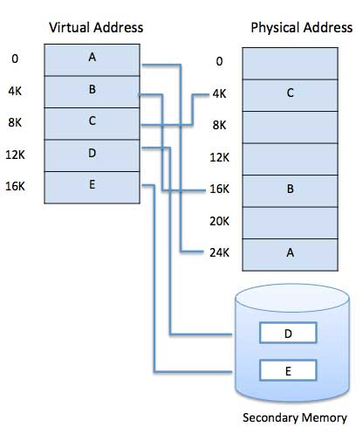
Virtual Memory
A program would no longer be constrained by the amount of physical memory that is available.
Users would be able to write programs for an extremely large virtual address space, simplifying the programming task.
Because each user program could take less physical memory.
More programs could be run at the same time, with a corresponding increase in CPU utilization and throughput.
With no increase in response time or turnaround time.

Slide 7
Virtual address space
The virtual address space of a process refers to the logical (or virtual) view of how a process is stored in memory.
The virtual address space for a process is the set of virtual memory addresses that it can use.
The address space for each process is private and cannot be accessed by other processes unless it is shared.
A virtual address does not represent the actual physical location of an object in memory.
Instead, the system maintains a page table for each process, which is an internal data structure used to translate virtual addresses into their corresponding physical addresses.
Each time a thread references an address, the system translates the virtual address to a physical address.

Slide 8
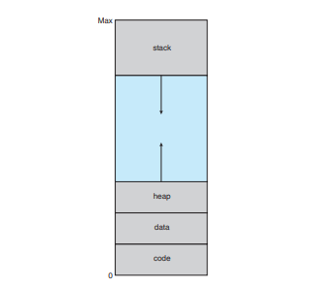
Virtual address space
In this view, a process begins at a certain logical address—say, address 0—and exists in contiguous memory, as shown in Figure.
Here it is allowed the heap to grow upward in memory as it is used for dynamic memory allocation.
Allows the stack to grow downward in memory through successive function calls.
The large blank space (or hole) between the heap and the stack is part of the virtual address space but will require actual physical pages only if the heap or stack grows.
Virtual address spaces that include holes are known as sparse address spaces.
Using a sparse address space is beneficial because the holes can be filled as the stack or heap segments grow or if we wish to dynamically link libraries (or possibly other shared objects) during program execution.
Virtual address space

Slide 9
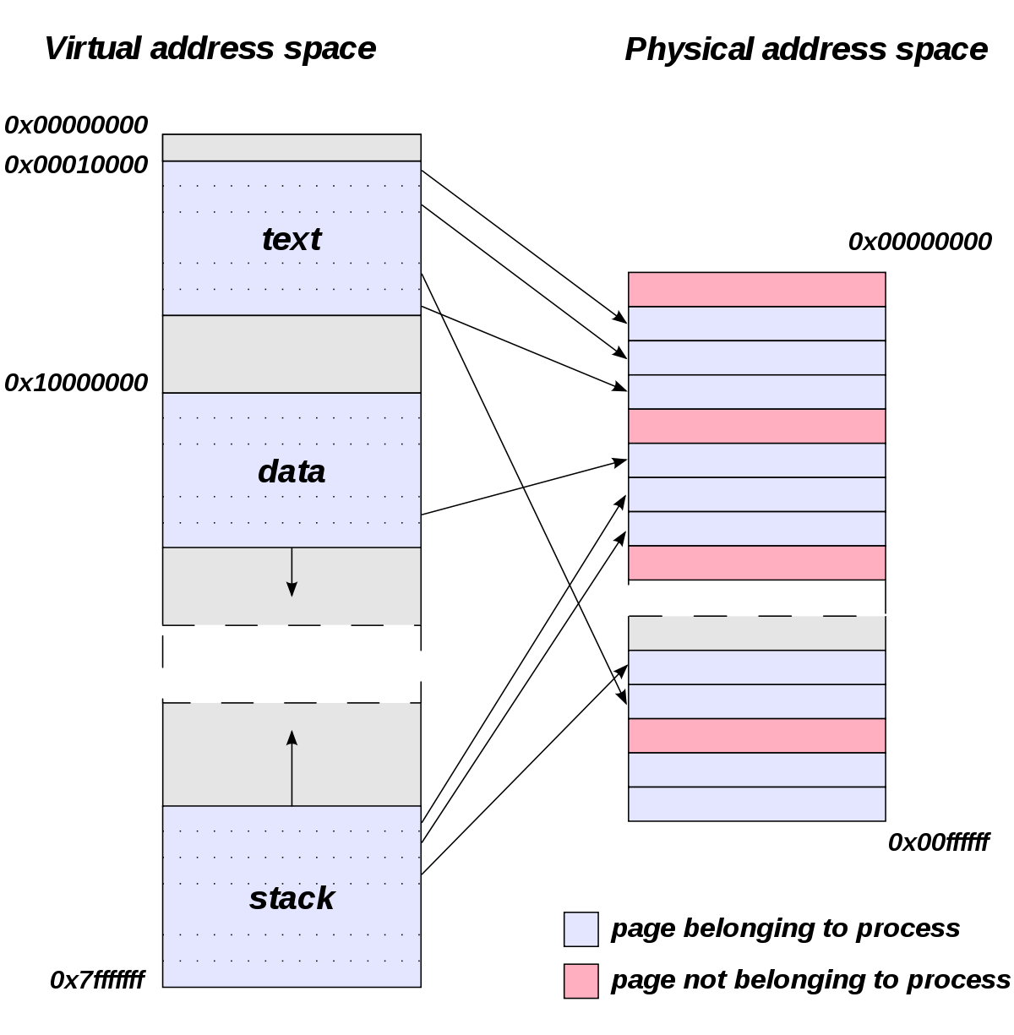
Virtual Address Space vs Physical Address Space
Address uniquely identifies a location in the memory.
The logical address is a virtual address and can be viewed by the user.
The user can’t view the physical address directly.
The logical address is used like a reference, to access the physical address.
Logical address is generated by CPU during a program execution whereas, the physical address refers to a location in the memory unit.

Slide 10
Shared Library Using Virtual Memory
In addition to separating logical memory from physical memory, virtual memory allows files and memory to be shared by two or more processes through page sharing.
This leads to the following benefits:
System libraries can be shared by several processes through mapping of the shared object into a virtual address space.
Although each process considers the libraries to be part of its virtual address space, the actual pages where the libraries reside in physical memory are shared by all the processes.
Typically, a library is mapped read-only into the space of each process that is linked with it, Similarly, processes can share memory.
Two or more processes can communicate through the use of shared memory.
Pages can be shared during process creation with the fork() system call, thus speeding up process creation.

Slide 11
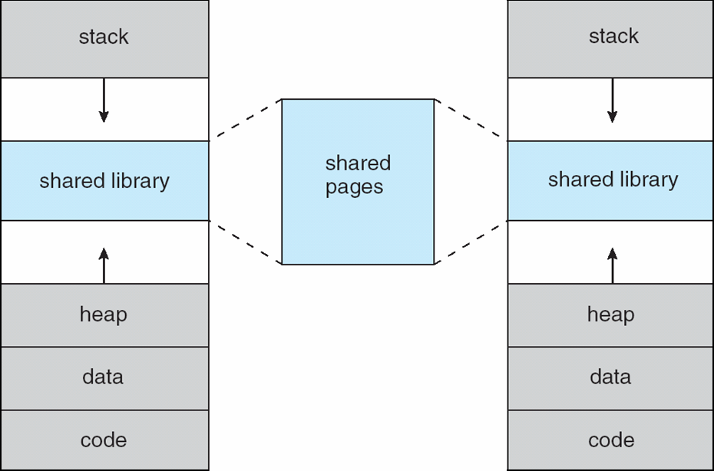
Shared Library Using Virtual Memory
Virtual memory allows one process to create a region of memory that it can share with another process.
Processes sharing this region consider it part of their virtual address space, yet the actual physical pages of memory are shared, much as is illustrated in Figure.

Slide 12
Demand Paging – Basic Concepts
How an executable program might be loaded from disk into memory?
Load the entire program in physical memory at program execution time.
problem of this method, we may not initially need the entire program in memory
An alternate approach to resolve this problem to load pages only as they are needed. This method called as Demand Paging.
Demand paging commonly used in virtual memory systems.
Demand paged virtual memory, pages are loaded only when they are needed during program execution.

Slide 13
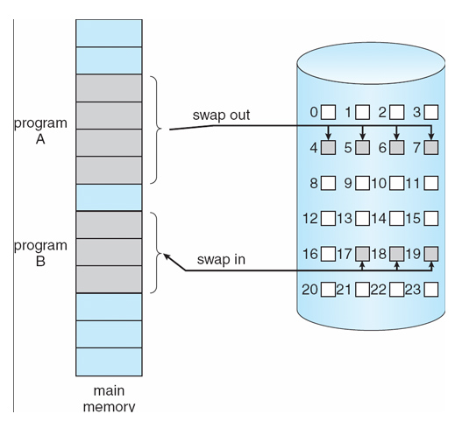
Demand Paging
A demand paging system is quite similar to a paging system with swapping where processes reside in secondary memory and pages are loaded only on demand, not in advance.

Slide 14
Demand Paging
In the context of a demand-paging system, use of the term “swapper” is technically incorrect.
Because swapper manipulates entire process into memory, whereas a pager is concerned with the individual pages of a process.
We thus use “pager,” rather than “swapper,” in connection with demand paging.
Lazy swapper – will not swap the entire process into memory, A lazy swapper never swaps a page into memory unless that page will be needed.

Slide 15
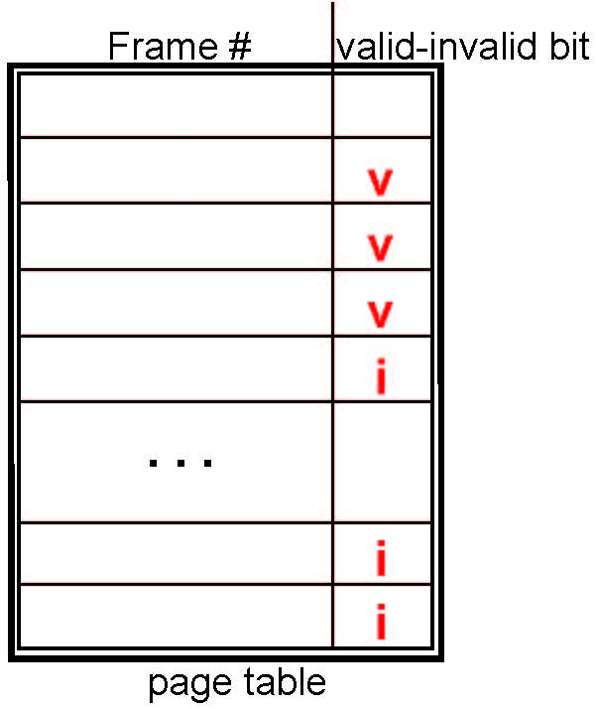
Valid-Invalid Bit
Need some form of hardware support to distinguish between the pages that are in memory and the pages that are on the disk.
The valid–invalid bit scheme can be used for this purpose.
With each page table entry a valid–invalid bit is associated (v ⇒ in-memory – memory resident, i ⇒ not-in-memory)
Initially valid–invalid bit is set to i on all entries.
Example of a page table snapshot:

Slide 16
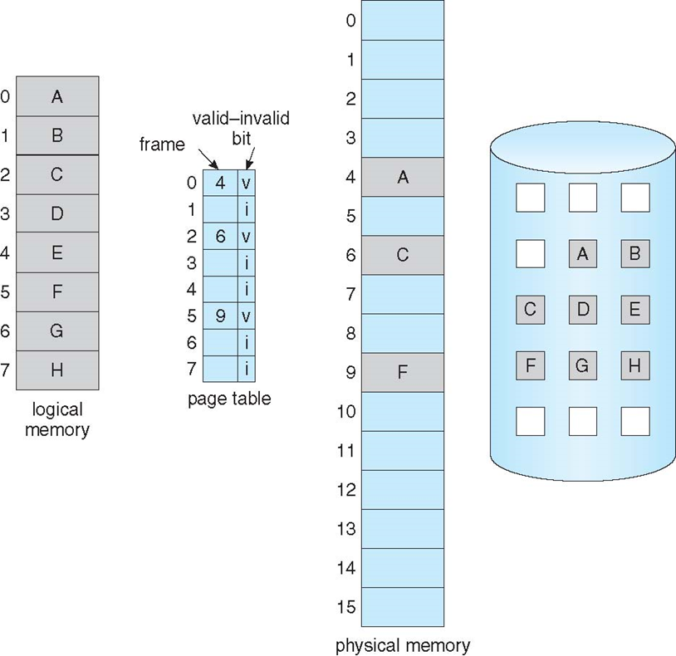
Page Table When Some Pages Are Not in Main Memory
Page fault - if the process tries to access a page that was not brought into memory.
Operating system’s failure to bring the desired page into memory.

Slide 17
Page Fault
The procedure for handling page fault
Check an internal table (usually kept with the process control block) whether the reference was a valid or an invalid memory access.
If the reference
Invalid, we terminate the process.
Valid but we have not yet brought in that page, we now page it in.
Find a free frame
Schedule a disk operation to read the desired page into the newly allocated frame.
When the disk read is complete, modify the internal table kept with the process and the page table to indicate that the page is now in memory.
We restart the instruction that was interrupted by the trap. The process can now access the page as though it had always been in memory.

Slide 18
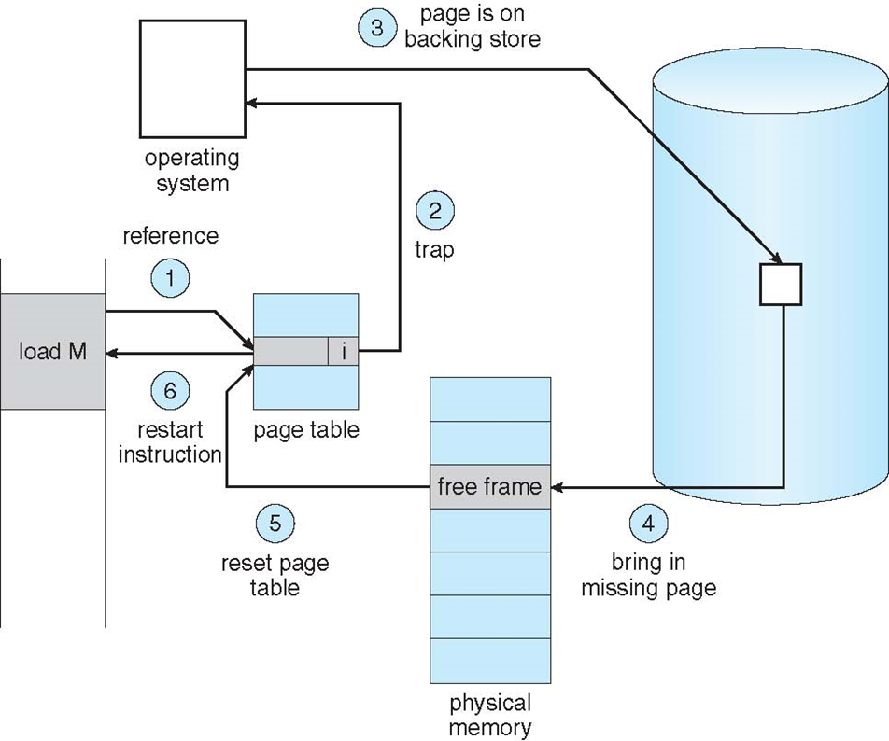
Steps in Handling a Page Fault

Slide 19
Aspects of Demand Paging
Extreme case – start process with no pages in memory
OS sets instruction pointer to first instruction of process, non-memory-resident -> page fault
After this page is brought into memory, the process continues to execute, faulting as necessary until every page that it needs is in memory.
At that point, it can execute with no more faults.
This scheme is pure demand paging: never bring a page into memory until it is required.
The hardware to support demand paging
Page table - This table has the ability to mark an entry invalid through a valid–invalid bit or a special value of protection bits.
Secondary memory - This memory holds those pages that are not present in main memory.
The secondary memory is usually a high-speed disk. It is known as the swap device

Slide 20
Performance of Demand Paging
Demand paging can significantly affect the performance of a computer system.
Memory-access time denoted ma, ranges from 10 to 200 nanoseconds. If there is no page faults, the effective access time is equal to the memory access time.
If page fault occurs, we must first read the relevant page from disk and then access the desired word.
Let p be the probability of a page fault (0 ≤ p ≤ 1).
We would expect p to be close to zero, expect to have only a few page faults.
The effective access time is then
effective access time = (1 − p) × ma + p × page fault time.
To compute the effective access time, we must know how much time is needed to service a page fault.

Slide 21
Performance of Demand Paging
A page fault causes the following sequence to occur:
Trap to the operating system
Save the user registers and process state
Determine that the interrupt was a page fault
Check that the page reference was legal and determine the location of the page on the disk
Issue a read from the disk to a free frame:
Wait in a queue for this device until the read request is serviced
Wait for the device seek and/or latency time
Begin the transfer of the page to a free frame
While waiting, allocate the CPU to some other user
Receive an interrupt from the disk I/O subsystem (I/O completed)
Save the registers and process state for the other user
Determine that the interrupt was from the disk
Correct the page table and other tables to show page is now in memory
Wait for the CPU to be allocated to this process again
Restore the user registers, process state, and new page table, and then resume the interrupted instruction

Slide 22
Performance of Demand Paging
Not all 12 steps are necessary in every case.
When the CPU is allocated to another process while waiting I/O occurs.
Allows multiprogramming to maintain CPU utilization but requires additional time to resume the page-fault service routine when the I/O transfer is complete.
In any case, we are faced with three major components of the page-fault service time:
Service the page-fault interrupt.
Read in the page.
Restart the process.

Slide 23
Performance of Demand Paging
The first and third tasks can be reduced, with careful coding to several hundred instructions. These tasks may take from 1 to 100 microseconds each.
Probably, The page-switch time - 8 milliseconds.
A typical hard disk has an average latency of 3 milliseconds,
A seek of 5 milliseconds
Remember also that we are looking at only the device-service time.
If a queue of processes is waiting for the device, we have to add device-queueing time

Slide 24
Performance of Demand Paging
For example,
Average page-fault service time - 8 milliseconds
memory access time - 200 nanoseconds
The effective access time?
effective access time = (1 − p) × ma + p × page fault time.
effective access time = (1 − p) × (200) + p (8 milliseconds)
= (1 − p) × 200 + p × 8,000,000
= 200 + 7,999,800 × p.
Let p be the probability of a page fault (0 ≤ p ≤ 1)
We see, then, that the effective access time is directly proportional to the page-fault rate.

Slide 25
Performance of Demand Paging
Swap space I/O faster than file system I/O even if on the same device
Swap allocated in larger chunks, less management needed than file system
Copy entire process image to swap space at process load time
Then page in and out of swap space
Used in older BSD Unix
Demand page in from program binary on disk, but discard rather than paging out when freeing frame
Used in Solaris and current BSD
Still need to write to swap space
Pages not associated with a file (like stack and heap) – anonymous memory
Pages modified in memory but not yet written back to the file system

Slide 26
Demand Paging
Advantages
Large virtual memory.
More efficient use of memory.
There is no limit on degree of multiprogramming.
Disadvantages
Number of tables and the amount of processor over head for handling page interrupts are greater than in the case of the simple paged management techniques.

Slide 27
Copy-on-Write
The fork() system call creates a child process that is a duplicate of its parent. Creating a copy of the parent’s address space for the child, duplicating the pages belonging to the parent.
Child processes invoke the exec() system call immediately after creation, the copying of the parent’s address space
Copy-on-Write (COW) allows both parent and child processes to initially share the same pages in memory
If either process modifies a shared page, only then is the page copied
COW allows more efficient process creation as only modified pages are copied

Slide 28
Copy-on-Write
The child process attempts to modify a page containing portions of the stack, with the pages set to be copy-on-write.
The operating system will create a copy of this page, mapping it to the address space of the child process.
The child process modify its copied page and not the page belonging to the parent process.
Obviously, when the copy-on-write technique is used, only the pages that are modified by either process are copied; all unmodified pages can be shared by the parent and child processes.
The following figure shows copy on write on page C

Slide 29
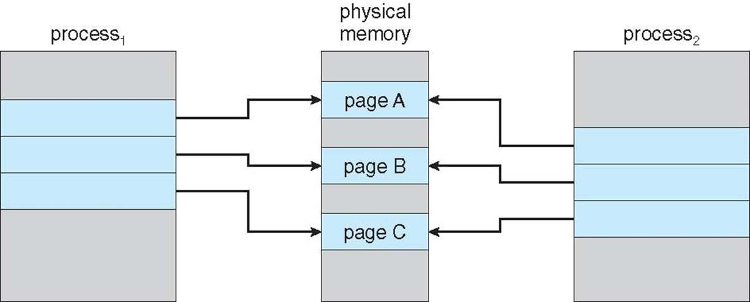
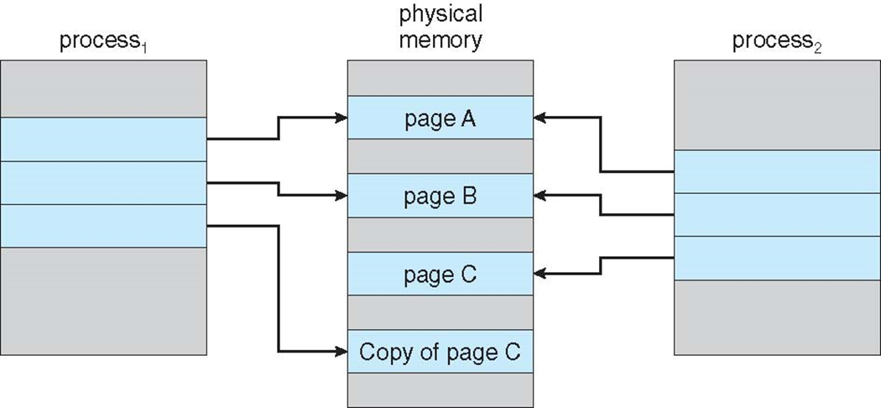
Before Process 1 Modifies Page C
After Process 1 Modifies Page C

Slide 30
Copy-on-Write
In general, free pages are allocated from a pool of zero-fill-on-demand pages
Pool should always have free frames for fast demand page execution
Don’t want to have to free a frame as well as other processing on page fault
Why zero-out a page before allocating it?
vfork() variation on fork() system call has parent suspend and child using copy-on-write address space of parent
Designed to have child call exec()
Very efficient

Slide 31
Need for Copy-on-Write
Copy-on-write or CoW is a technique to efficiently copy data resources in a computer system.
If a unit of data is copied but not modified, the "copy" can exist as a reference to the original data.
Only when the copied data is modified is a copy created, and new bytes are actually written.
Copy-on-write is closely related to data deduplication.
Whereas data deduplication analyzes chunks or blocks of data, copy-on-write applies to entire files or allocated units of memory.

Slide 32

Page Replacement Algorithms
Page replacement is a process of swapping out an existing page from the frame of a main memory and replacing it with the required page.
Reason for Page Replacement
Page fault
A page fault occurs when a page referenced by the CPU is not found in the main memory.
The only solution for the page fault is, the required page has to be brought from the secondary memory into the main memory.
This is done by replacing the already occupied page in the main memory with the desired page.

Slide 33
Steps in Page Replacement
Identify the location of the desired page on the disk.
If the page fault occurs, identify a free frame
If there is a free frame then locate the desired page into the free frame
If there is no free frame then use a page-replacement algorithm to select a victim frame that is to be replaced.
Now write the victim page to the disk then update the page and frame tables.
Read the desired page into the newly freed frame then change the page and frame tables.
Continue the process when there is a page fault occurs again

Slide 34
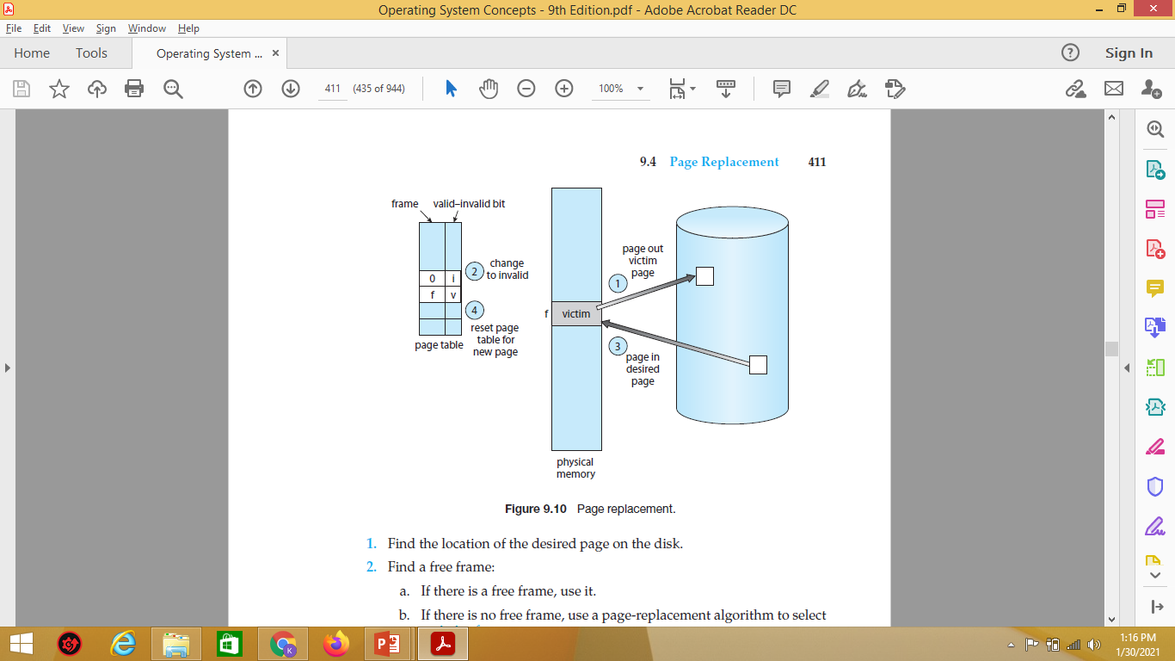
Steps in Page Replacement

Slide 35
Page Replacement Algorithms
Page replacement algorithms help to decide which page must be swapped out from the main memory to create a room for the incoming page.
Various page replacement algorithms are
First In First Out (FIFO) page replacement algorithm
Optimal page replacement algorithm
Least Recently Used (LRU) page replacement algorithm
LRU Approximation page replacement algorithm
Additional Reference Bits Algorithm
Second Chance / Clock Algorithm
Enhanced Second Chance Algorithm
Counting Based page replacement algorithm
Least Frequently Used (LRU) page replacement algorithm
Most Frequently Used (MRU) page replacement algorithm
Page Buffering algorithm

Slide 36
FIFO Page Replacement Algorithm
As the name suggests, this algorithm works on the principle of “First in First out“.
It replaces the oldest page that has been present in the main memory for the longest time.
It is implemented by keeping track of all the pages in a queue.
Steps in FIFO
Bring the page into the queue
If page is available then do
Else there is a page fault
If there is a free frame, locate the desired page which causes the page fault
If there is no free frame, identify the victim frame to be replaced
The page which comes first into the queue will be chosen as the victim frame.
Now this victim frame will be replaced with the desired page and the queue is updated for further process.

Slide 37
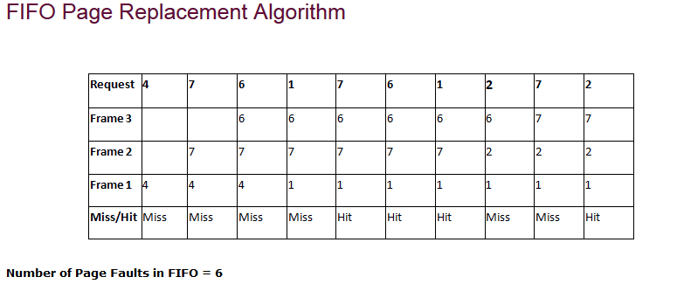
FIFO Page replacement algorithms
Queue after second replacement
4*
7
6
7*
6
1
6*
1
2
1*
2
7
Initial Queue
Queue after first replacement
Queue after third replacement
* Indicates the top element of the queue or the element which comes first into the queue

Slide 38
FIFO Illustrating Belady’s Anomaly
If number of page frames increases page fault also increases. This is called as Belady’s Anomaly

Slide 39
Optimal Page Replacement Algorithm
This algorithm replaces the page that will not be referred by the CPU in future for the longest time.
It is practically difficult to implement this algorithm.
This is because the pages that will not be used in future for the longest time cannot be predicted.
However, it is the best known algorithm and gives the least number of page faults.
Hence, it is used as a performance measure criterion for other algorithms.

Slide 40
Optimal Page Replacement Algorithm
Steps in the Working Process (This is only for understanding purpose)
Create required number of columns based on the reference strings used
A pointer is used which moves from MSB to LSB of the columns
The pointer identifies the future reference of the strings
If the page fault occurs, identify the free frame
If there is a free frame, locate the desired page into the free frame
If there is no free frames, choose a victim frame that is to replaced with the desired page
The victim frame is chosen by the pointer, where the pointer choses a victim frame which will be referred very later in the future
Now the desired page is located in the main memory which caused the page fault

Slide 41
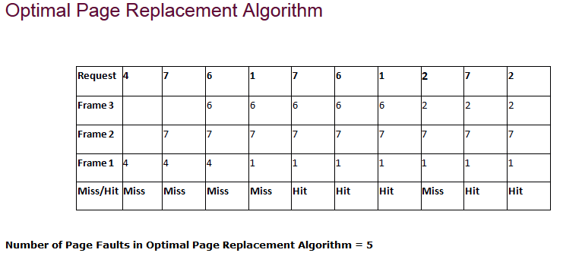
1 | 2 | 3 | 4 | 5 | 6 | 7 | 8 | 9 | 10
4 | 7 | 6 | 1 | 7 | 6 | 1 | 2 | 7 | 2
7 is again referred in 5th and 9th position in the future
6 is again referred in 6th position in the future
1 is again referred in 7th position in the future
2 is again referred in 10th position in the future
4 is not referred in the future

Slide 42
LRU Page Replacement Algorithm
As the name suggests, this algorithm works on the principle of “Least Recently Used“.
It replaces the page that has not been referred by the CPU for the longest time.
Use past knowledge rather than future
Additionally LRU can be implemented using counter and stack

Slide 43
The LRU policy is often used as a page-replacement algorithm and is considered to be good. The major problem is how to implement LRU replacement. An LRU page-replacement algorithm may require substantial hardware assistance. The problem is to determine an order for the frames defined by the time of last use. Two implementations are feasible:

Slide 44
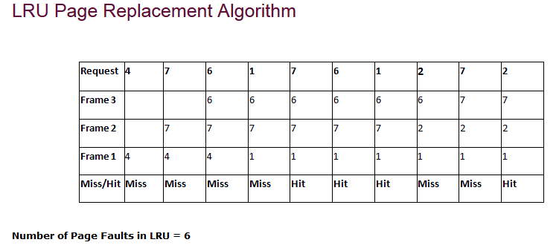
Positions
1 | 2 | 3 | 4 | 5 | 6 | 7 | 8 | 9 | 10
4 is referred in the 1st position before, so it is replaced
7 is referred in the 2nd position before, so it is replaced
6 is referred in the 3nd position before, so it is replaced

Slide 45
LRU IMPLEMENTATION
Counter implementation
Every page entry has a counter
The counter is incremented for every memory reference.
Counters.- In the simplest case, we associate with each page-table entry a time-of-use field and add to the CPU a logical clock or counter.
every time page is referenced through this entry
When a page needs to be changed, look at the counters to find smallest value Search through table

Slide 46
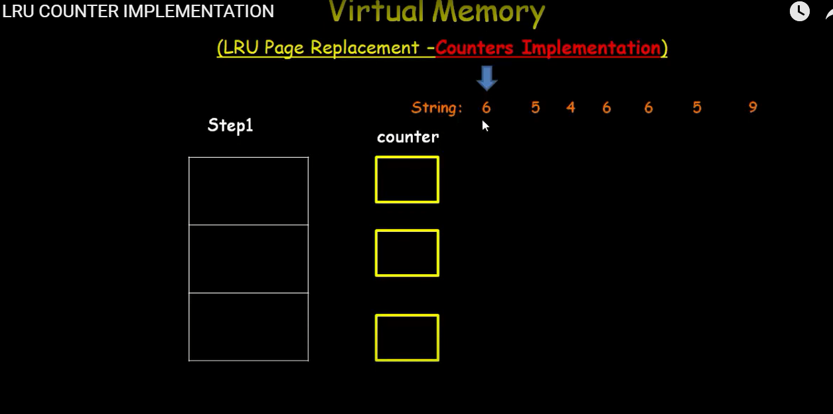

Slide 47
LRU IMPLEMENTATION
Stack implementation
Keep a stack of page numbers in a double link form
If Page referenced
move it to the top
requires 6 pointers to be changed
But each update more expensive
No search for replacement
LRU and OPT are cases of stack algorithms that don’t have Belady’s Anomaly

Slide 48
Stack to Record Most Recent Page References

Slide 49
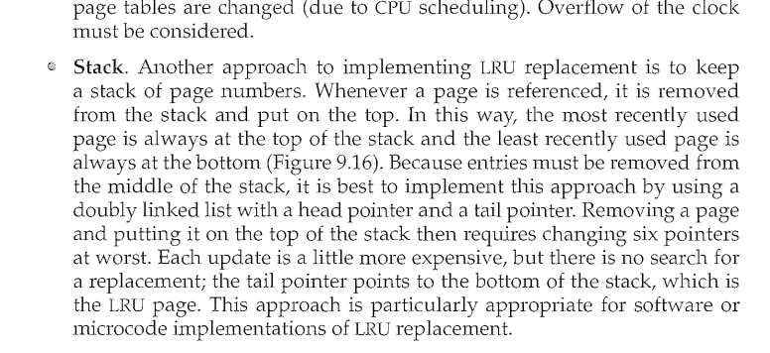

Slide 50
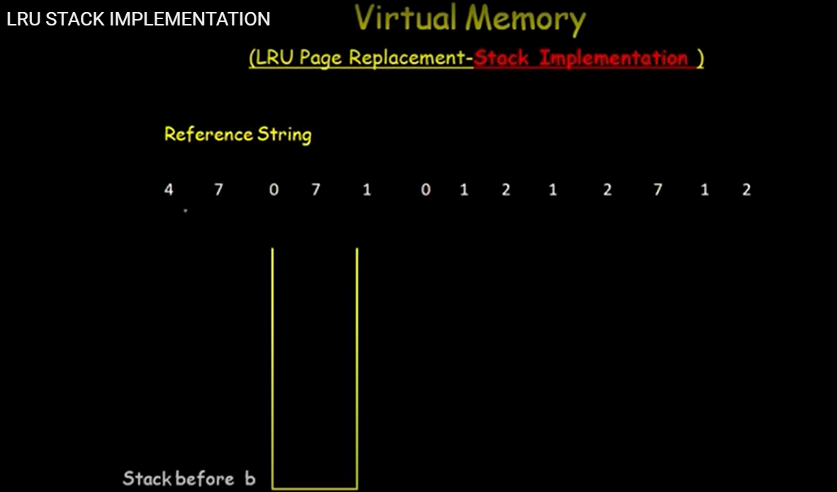
9

Slide 51
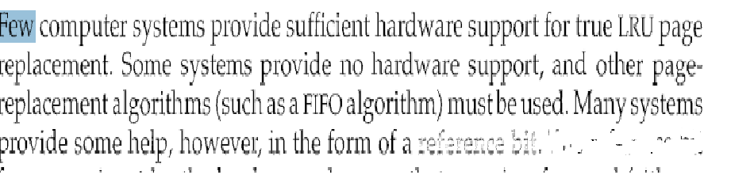
LRU Approximation Algorithms
Initially, all bits are cleared (to 0) by the operating system. As a user process executes, the bit associated with each page referenced is set (to 1) by the hardware.
After some time, we can determine which pages have been used and which have not been used by examining the reference bits, although we do not know the order of use.
This information is the basis for many page-replacement algorithms that approximate LRU replacement.

Slide 52
LRU Approximation – Additional Reference Bits Algorithm
Limitations in using single reference bit had been solved by providing the order of the pages
Additional reference bits are ‘1’ byte in capacity
Already existing reference bits are shifted to right in the additional reference bits table
Page with the lowest number is the least recently used which will be chosen for replacement
FIFO can be used at the time of tie

Slide 53
Initially all the bits are set to ‘0’
Reference Bit
Additional Bits
Page 0
Page 1
Page 2
Page 3
Page 4
0
0
0
0
0
0 | 0 | 0 | 0 | 0 | 0 | 0 | 0
0 | 0 | 0 | 0 | 0 | 0 | 0 | 0
0 | 0 | 0 | 0 | 0 | 0 | 0 | 0
0 | 0 | 0 | 0 | 0 | 0 | 0 | 0
0 | 0 | 0 | 0 | 0 | 0 | 0 | 0

Slide 54
Pages 1 and 3 are referred
Reference Bit
Additional Bits
Page 0
Page 1
Page 2
Page 3
Page 4
0
1
0
1
0
0 | 0 | 0 | 0 | 0 | 0 | 0 | 0
0 | 0 | 0 | 0 | 0 | 0 | 0 | 0
0 | 0 | 0 | 0 | 0 | 0 | 0 | 0
0 | 0 | 0 | 0 | 0 | 0 | 0 | 0
0 | 0 | 0 | 0 | 0 | 0 | 0 | 0

Slide 55
The referred bit is copied to the MSB of the additional bits and reset the reference bit to ‘0’
Reference Bit
Additional Bits
Page 0
Page 1
Page 2
Page 3
Page 4
0
0
0
0
0
0 | 0 | 0 | 0 | 0 | 0 | 0 | 0
1 | 0 | 0 | 0 | 0 | 0 | 0 | 0
0 | 0 | 0 | 0 | 0 | 0 | 0 | 0
1 | 0 | 0 | 0 | 0 | 0 | 0 | 0
0 | 0 | 0 | 0 | 0 | 0 | 0 | 0

Slide 56
Now pages 1 and 2 are referred. Then the bits which are present already in the MSB of the Additional bits table is shifted to right one place
Reference Bit
Additional Bits
Page 0
Page 1
Page 2
Page 3
Page 4
0
1
1
0
0
0 | 0 | 0 | 0 | 0 | 0 | 0 | 0
0 | 1 | 0 | 0 | 0 | 0 | 0 | 0
0 | 0 | 0 | 0 | 0 | 0 | 0 | 0
0 | 1 | 0 | 0 | 0 | 0 | 0 | 0
0 | 0 | 0 | 0 | 0 | 0 | 0 | 0

Slide 57
Again the process continues by copying the referred bits to the MSB of Additional bits table
Reference Bit
Additional Bits
Page 0
Page 1
Page 2
Page 3
Page 4
0
0
0
0
0
0 | 0 | 0 | 0 | 0 | 0 | 0 | 0
1 | 1 | 0 | 0 | 0 | 0 | 0 | 0
1 | 0 | 0 | 0 | 0 | 0 | 0 | 0
0 | 1 | 0 | 0 | 0 | 0 | 0 | 0
0 | 0 | 0 | 0 | 0 | 0 | 0 | 0

Slide 58
If we interpret these 8-bit bytes as unsigned integers, the page with the lowest number is the LRU page, and it can be replaced.
Notice that the numbers are not guaranteed to be unique, however. We can either replace (swap out) all pages with the smallest value or use the FIFO method to choose among them.

Slide 59
LRU Approximation – Second Chance/Clock Algorithm
By default FIFO is used
Page is replaced based on reference bit
If the reference bit is ‘0’ then the page is considered as not recently used and taken for replacement
If the reference bit is ‘1’ then the page is considered as recently used and it is given a second chance to stay in the memory
Now its reference bit is reset to ‘0’

Slide 60
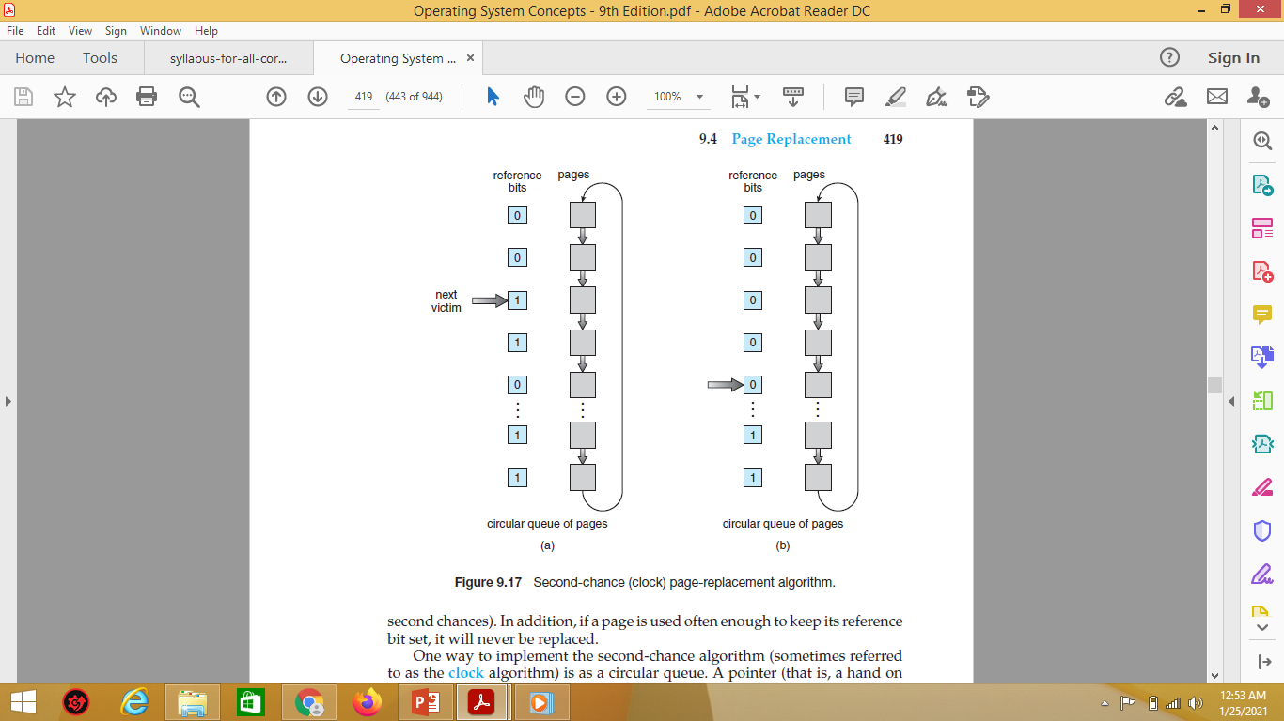
Fig (a) denotes next victim as page containing reference bits as 1, Fig (b) denotes that second chance is given to the referred pages and points the next victim as page containing reference bit as ‘0’
At the mean time the reference bit is reset to ‘0’ for the page who got the second chance

Slide 61
reference strings - 3 3 5 4 7 1 5 5 1 4 3 7 6 3 4 1
3₀
3₁
3₁
3₁
5₀
5₀
4₀
3₁
3₀
3₀
3₀
7₀
5₀
7₀
1₀
7₀
1₀
7₀
1₀
4₀
4₀
5₀
5₁
3₀
3₀
3₁
3₀
7₀
1₁
4₀
1₁
4₀
1₁
7₀
1₀
5₁
5₁
5₁
5₀

Slide 62
reference strings - 3 3 5 4 7 1 5 5 1 4 3 7 6 3 4 1
3₀
3₀
3₁
3₀
7₀
1₁
4₀
1₁
4₀
1₁
7₀
1₀
5₁
5₁
5₁
5₀
6₀
6₀
6₀
6₀
7₀
1₀
7₀
3₀
7₀
3₀
1₀
3₀
5₀
5₀
4₀
4₀
Number of page hits – 4
Number of page faults – 12

Slide 63
LRU Approximation – Enhanced Second Chance Algorithm
Use both the reference bit and modify bit for the replacement
(0,0) – neither recently used or modified – best to replace
(0,1) – not recently used but modified – page needs to be written before replacement
(1,0) – recently used but clean – probably will be used again soon
(1,1) – recently used and modified – may be used again, has to be written to the disk
Out of these four classes, the page which falls under (0,0) will be replaced first, then (0,1) will be chosen for replacement, next (1,0) and finally (1,1) will be chosen for replacement

Slide 64
Understanding the Pros and cons of the page replacement techniques
FIFO Page Replacement Algorithm
Advantages
Easy to understand and execute
Disadvantages
It is not very effective
System needs to keep track of each frame
Page fault increases when increasing the page frames, undergoes Belady’s anomaly

Slide 65
Understanding the Pros and cons of the page replacement techniques
Optimal Page Replacement Algorithm
Advantages
Lowest page fault rate
Never suffers from Belady's anomaly
Twice as good as FIFO
Disadvantages
Difficult to implement
It needs forecast i.e. Future knowledge

Slide 66
Understanding the Pros and cons of the page replacement techniques
LRU Page Replacement Algorithms
Advantages
It is amenable to full statistical analysis
Never suffers from Belady's anomaly
Easy to identify the faulty page that is not needed to long time
Disadvantages
It has more complexity
Need additional Data Structure and high hardware support

Slide 67
COUNTING ALGORITHMS
It keeps count of number of references (frequencies) made to each page in a reference string
Whenever a page comes in its frequency increases
Whenever a page leaves the memory its frequency is reset
Least frequently used page replacement
Page with least number of frequency is replaced first
Assumption – Heavily used page will be referred again
When there is a tie in frequencies, then use FIFO

Slide 68
COUNTING ALGORITHMS
Most Frequently used Page replacement algorithm
A page which has maximum number of frequencies in the counter will be replaced first
Assumption – The page just brought in the memory is yet to use again
If there is a tie in frequencies use FIFO for replacement

Slide 69
Reference String – 0, 2, 0, 1, 0, 3, 2, 1, 2, 3 Total Frames allocated – 3 Perform LFU
0 | 2 | 0 | 1 | 0 | 3 | 2 | 1 | 2 | 3
Counter value of each page | Page 0 : 0 | Page 1 : 0 | Page 2 : 0 | Page 3 : 0

Slide 70
Reference String – 0, 2, 0, 1, 0, 3, 2, 1, 2, 3 Total Frames allocated – 3 Perform LFU
0 | 2 | 0 | 1 | 0 | 3 | 2 | 1 | 2 | 3
0
F
Counter value of each page | Page 0 : 1 | Page 1 : 0 | Page 2 : 0 | Page 3 : 0

Slide 71
Reference String – 0, 2, 0, 1, 0, 3, 2, 1, 2, 3 Total Frames allocated – 3 Perform LFU
0 | 2 | 0 | 1 | 0 | 3 | 2 | 1 | 2 | 3
0 | 0
 | 2
F | F
Counter value of each page | Page 0 : 1 | Page 1 : 0 | Page 2 : 1 | Page 3 : 0

Slide 72
Reference String – 0, 2, 0, 1, 0, 3, 2, 1, 2, 3 Total Frames allocated – 3 Perform LFU
0 | 2 | 0 | 1 | 0 | 3 | 2 | 1 | 2 | 3
0 | 0 | 0
 | 2 | 2
F | F | H
Counter value of each page | Page 0 : 2 | Page 1 : 0 | Page 2 : 1 | Page 3 : 0

Slide 73
Reference String – 0, 2, 0, 1, 0, 3, 2, 1, 2, 3 Total Frames allocated – 3 Perform LFU
0 | 2 | 0 | 1 | 0 | 3 | 2 | 1 | 2 | 3
0 | 0 | 0 | 0
 | 2 | 2 | 2
 |  |  | 1
F | F | H | F
Counter value of each page | Page 0 : 2 | Page 1 : 1 | Page 2 : 1 | Page 3 : 0

Slide 74
Reference String – 0, 2, 0, 1, 0, 3, 2, 1, 2, 3 Total Frames allocated – 3 Perform LFU
0 | 2 | 0 | 1 | 0 | 3 | 2 | 1 | 2 | 3
0 | 0 | 0 | 0 | 0
 | 2 | 2 | 2 | 2
 |  |  | 1 | 1
F | F | H | F | H
Counter value of each page | Page 0 : 3 | Page 1 : 1 | Page 2 : 1 | Page 3 : 0

Slide 75
Reference String – 0, 2, 0, 1, 0, 3, 2, 1, 2, 3 Total Frames allocated – 3 Perform LFU
0 | 2 | 0 | 1 | 0 | 3 | 2 | 1 | 2 | 3
0 | 0 | 0 | 0 | 0 | 0
 | 2 | 2 | 2 | 2 | 3
 |  |  | 1 | 1 | 1
F | F | H | F | H | F
Counter value of each page | Page 0 : 3 | Page 1 : 1 | Page 2 : 0 | Page 3 : 1

Slide 76
Reference String – 0, 2, 0, 1, 0, 3, 2, 1, 2, 3 Total Frames allocated – 3 Perform LFU
0 | 2 | 0 | 1 | 0 | 3 | 2 | 1 | 2 | 3
0 | 0 | 0 | 0 | 0 | 0 | 0
 | 2 | 2 | 2 | 2 | 3 | 3
 |  |  | 1 | 1 | 1 | 2
F | F | H | F | H | F | F
Counter value of each page | Page 0 : 3 | Page 1 : 0 | Page 2 : 1 | Page 3 : 1

Slide 77
Reference String – 0, 2, 0, 1, 0, 3, 2, 1, 2, 3 Total Frames allocated – 3 Perform LFU
0 | 2 | 0 | 1 | 0 | 3 | 2 | 1 | 2 | 3
0 | 0 | 0 | 0 | 0 | 0 | 0 | 0
 | 2 | 2 | 2 | 2 | 3 | 3 | 1
 |  |  | 1 | 1 | 1 | 2 | 2
F | F | H | F | H | F | F | F
Counter value of each page | Page 0 : 3 | Page 1 : 1 | Page 2 : 1 | Page 3 : 0

Slide 78
Reference String – 0, 2, 0, 1, 0, 3, 2, 1, 2, 3 Total Frames allocated – 3 Perform LFU
0 | 2 | 0 | 1 | 0 | 3 | 2 | 1 | 2 | 3
0 | 0 | 0 | 0 | 0 | 0 | 0 | 0 | 0
 | 2 | 2 | 2 | 2 | 3 | 3 | 1 | 1
 |  |  | 1 | 1 | 1 | 2 | 2 | 2
F | F | H | F | H | F | F | F | H
Counter value of each page | Page 0 : 3 | Page 1 : 1 | Page 2 : 2 | Page 3 : 0

Slide 79
Reference String – 0, 2, 0, 1, 0, 3, 2, 1, 2, 3 Total Frames allocated – 3 Perform LFU
0 | 2 | 0 | 1 | 0 | 3 | 2 | 1 | 2 | 3
0 | 0 | 0 | 0 | 0 | 0 | 0 | 0 | 0 | 0
 | 2 | 2 | 2 | 2 | 3 | 3 | 1 | 1 | 3
 |  |  | 1 | 1 | 1 | 2 | 2 | 2 | 2
F | F | H | F | H | F | F | F | H | F
Counter value of each page | Page 0 : 3 | Page 1 : 0 | Page 2 : 2 | Page 3 : 1
Number of page hits – 3
Number of page faults – 7

Slide 80
Reference String – 0, 2, 0, 1, 0, 3, 2, 1, 2, 3 Total Frames allocated – 3 Perform MFU
0 | 2 | 0 | 1 | 0 | 3 | 2 | 1 | 2 | 3
Counter value of each page | Page 0 : 0 | Page 1 : 0 | Page 2 : 0 | Page 3 : 0

Slide 81
Reference String – 0, 2, 0, 1, 0, 3, 2, 1, 2, 3 Total Frames allocated – 3 Perform MFU
0 | 2 | 0 | 1 | 0 | 3 | 2 | 1 | 2 | 3
0
F
Counter value of each page | Page 0 : 1 | Page 1 : 0 | Page 2 : 0 | Page 3 : 0

Slide 82
Reference String – 0, 2, 0, 1, 0, 3, 2, 1, 2, 3 Total Frames allocated – 3 Perform MFU
0 | 2 | 0 | 1 | 0 | 3 | 2 | 1 | 2 | 3
0 | 0
 | 2
F | F
Counter value of each page | Page 0 : 1 | Page 1 : 0 | Page 2 : 1 | Page 3 : 0

Slide 83
Reference String – 0, 2, 0, 1, 0, 3, 2, 1, 2, 3 Total Frames allocated – 3 Perform MFU
0 | 2 | 0 | 1 | 0 | 3 | 2 | 1 | 2 | 3
0 | 0 | 0
 | 2 | 2
F | F | H
Counter value of each page | Page 0 : 2 | Page 1 : 0 | Page 2 : 1 | Page 3 : 0

Slide 84
Reference String – 0, 2, 0, 1, 0, 3, 2, 1, 2, 3 Total Frames allocated – 3 Perform MFU
0 | 2 | 0 | 1 | 0 | 3 | 2 | 1 | 2 | 3
0 | 0 | 0 | 0
 | 2 | 2 | 2
 |  |  | 1
F | F | H | F
Counter value of each page | Page 0 : 2 | Page 1 : 1 | Page 2 : 1 | Page 3 : 0

Slide 85
Reference String – 0, 2, 0, 1, 0, 3, 2, 1, 2, 3 Total Frames allocated – 3 Perform MFU
0 | 2 | 0 | 1 | 0 | 3 | 2 | 1 | 2 | 3
0 | 0 | 0 | 0 | 0
 | 2 | 2 | 2 | 2
 |  |  | 1 | 1
F | F | H | F | H
Counter value of each page | Page 0 : 3 | Page 1 : 1 | Page 2 : 1 | Page 3 : 0

Slide 86
Reference String – 0, 2, 0, 1, 0, 3, 2, 1, 2, 3 Total Frames allocated – 3 Perform MFU
0 | 2 | 0 | 1 | 0 | 3 | 2 | 1 | 2 | 3
0 | 0 | 0 | 0 | 0 | 3
 | 2 | 2 | 2 | 2 | 2
 |  |  | 1 | 1 | 1
F | F | H | F | H | F
Counter value of each page | Page 0 : 0 | Page 1 : 1 | Page 2 : 1 | Page 3 : 1

Slide 87
Reference String – 0, 2, 0, 1, 0, 3, 2, 1, 2, 3 Total Frames allocated – 3 Perform MFU
0 | 2 | 0 | 1 | 0 | 3 | 2 | 1 | 2 | 3
0 | 0 | 0 | 0 | 0 | 3 | 3
 | 2 | 2 | 2 | 2 | 2 | 2
 |  |  | 1 | 1 | 1 | 1
F | F | H | F | H | F | H
Counter value of each page | Page 0 : 0 | Page 1 : 1 | Page 2 : 2 | Page 3 : 1

Slide 88
Reference String – 0, 2, 0, 1, 0, 3, 2, 1, 2, 3 Total Frames allocated – 3 Perform MFU
0 | 2 | 0 | 1 | 0 | 3 | 2 | 1 | 2 | 3
0 | 0 | 0 | 0 | 0 | 3 | 3 | 3
 | 2 | 2 | 2 | 2 | 2 | 2 | 2
 |  |  | 1 | 1 | 1 | 1 | 1
F | F | H | F | H | F | H | H
Counter value of each page | Page 0 : 0 | Page 1 : 2 | Page 2 : 2 | Page 3 : 1

Slide 89
Reference String – 0, 2, 0, 1, 0, 3, 2, 1, 2, 3 Total Frames allocated – 3 Perform MFU
0 | 2 | 0 | 1 | 0 | 3 | 2 | 1 | 2 | 3
0 | 0 | 0 | 0 | 0 | 3 | 3 | 3 | 3
 | 2 | 2 | 2 | 2 | 2 | 2 | 2 | 2
 |  |  | 1 | 1 | 1 | 1 | 1 | 1
F | F | H | F | H | F | H | H | H
Counter value of each page | Page 0 : 0 | Page 1 : 2 | Page 2 : 3 | Page 3 : 1

Slide 90
Reference String – 0, 2, 0, 1, 0, 3, 2, 1, 2, 3 Total Frames allocated – 3 Perform MFU
0 | 2 | 0 | 1 | 0 | 3 | 2 | 1 | 2 | 3
0 | 0 | 0 | 0 | 0 | 3 | 3 | 3 | 3 | 3
 | 2 | 2 | 2 | 2 | 2 | 2 | 2 | 2 | 2
 |  |  | 1 | 1 | 1 | 1 | 1 | 1 | 1
F | F | H | F | H | F | H | H | H | H
Counter value of each page | Page 0 : 0 | Page 1 : 2 | Page 2 : 3 | Page 3 : 2
Number of page hits – 6
Number of page faults – 4

Slide 91
Page-Buffering Algorithms
Used in addition to page replacement algorithms
System keeps a pool of free frames
When a page fault occurs
Victim frame is chosen
- but requires some time to choose the victim frame
At that time desired page is read into a free frame which
is maintained by the system
- By doing this the desired page can start doing its
work without waiting for the swapping
process of the victim frame in the main memory
Victim frame is written out later
Finally Victim frame is added to the pool of free frames

Slide 92
Page-Buffering Algorithms
Another idea is to maintain a list of modified pages
Whenever paging device is idle, a modified page is selected and written to the disk
When there is read/write operation at that time paging device does this job
Modify bit is then reset
Increases the probability that a page is clean when chosen for replacement
Used to identify the clean pages very quickly, because after performing this operation maximum modified pages will be already written to the disk
Makes the replacement very easy

Slide 93
Page-Buffering Algorithms
Yet Another idea is to keep a pool of free frames
Remember which page was in each frame
If the same page is needed again, it is taken from the pool of free frames and used
But the page should not be modified for reusing
No I/O operation is required
If the required page is not in the pool of free frames, another free frame is selected
The new page is read into free frame

Slide 94

Allocation of Frames
How do we allocate the fixed amount of free memory among the various process?
Example: If we have 93 free frames and 2 processes, How many frames does each process get?
Consider a single-user system with 128 KB of memory composed of pages 1 KB in size.
This system has 128 frames.
The operating system may take 35 KB of memory and
Leaving remaining 93 frames for the user process.
Other possible strategy: the user process is allocated with any free frame.

Slide 95
Demand paging Vs. Pure Demand paging
Demand paging Pure Demand paging
In demand paging, a page is not loaded into main memory until it is needed.
In Demand paging follows that pages should only be brought into memory if the executing process demands them.
In pure demand paging, even a single page is not loaded into memory initially. Hence pure demand paging causes a page fault. Page fault, the situation in which the page is not available whenever a processor needs to execute it.
while in pure demand paging swapping, where all memory for a process is swapped from secondary storage to main memory during the process startup.

Slide 96
Allocation of Frames – Pure Demand Paging
Under Pure demand paging:
All 93 frames - initially kept on free-frame list.
When a user process started execution, it would generate a sequence of page faults.
There is not page fault up to 93 frames.
When the free-frame list was exhausted then a page-replacement algorithm would be called to select one of the 93 in-memory pages to be replaced with the 94th, and so on.
When the process terminated, the 93 frames would once again be placed on the free-frame list.

Slide 97
Allocation of Frames
Each process needs minimum number of frames
Allocating minimum number of frames impacts on the performance.
If the number of frames allocated to each process decreases, the page-fault rate increases, which slow downs the execution of process
Also when a page fault occurs before completion of an executing then the instruction must be restarted.
It is necessary to hold all the different pages that any single instruction can reference.
Example: IBM 370 – 6 pages to handle storage to storage (SS) MOVE instruction:
instruction is 6 bytes, might span 2 pages
2 pages to handle from one storage area
2 pages to handle to another storage area

Slide 98
Allocation schemes
Minimum number of frames per process is defined by the architecture.
Maximum number is defined by the amount of available physical memory in the system
In between is still left with significant choice of frame allocation.
Two major allocation schemes
Fixed allocation
Equal Allocation
Proportional Allocation
Priority allocation

Slide 99
Fixed Allocation
Equal allocation – For example, if there are 100 frames (after allocating frames for the OS) and 5 processes, give each process 20 frames
Keep some as free frame buffer pool
Proportional allocation – Allocate according to the size of process
Dynamic as degree of multiprogramming, process sizes change
Consider a system with a 1-KB frame size. If a small student process of 10 KB and an interactive database of 127 KB are the only two processes running in a system with 62 free frames, it does not make much sense to give each process 31 frames. The student process does not need more than 10 frames, so the other 21 are, strictly speaking, wasted

Slide 100
Fixed Allocation – Contd.
In equal and proportional allocation
If the multiprogramming level is increased, each process will lose some frames for the new process.
if the multiprogramming level decreases, the frames that were allocated from departed process are spread to the remaining processes.

Slide 101
Priority Allocation
Suppose if we want to give the high-priority process with more memory to speed up its execution than the low-priority processes.
Use a proportional allocation scheme using priorities rather than size
If process P_{i} generates a page fault,
select for replacement one of its frames
select for replacement a frame from a process with lower priority number

Slide 102
Frame Allocation - Another factor
Multiple processes competing for frames, we can classify page-replacement algorithms into two broad categories namely Global and Local.
Global replacement
Process selects a replacement frame from the set of all frames; one process can take a frame from another
But then process execution time can vary greatly
But greater throughput so more common
Local replacement
Each process selects from only its own set of allocated frames
More consistent per-process performance
But possibly underutilized memory

Slide 103
Global vs. Local Allocation – Contd.
If, we allow high-priority processes to select frames from low-priority processes for replacement
Global replacement, approach allows a high-priority process to increase its frame allocation at the expense of a low-priority process
Local replacement, the number of frames allocated to a process does not change.

Slide 104
Non-Uniform Memory Access (NUMA)
So far all memory accessed equally
Many systems are NUMA – speed of access to memory varies
Consider system boards containing CPUs and memory, interconnected over a system bus
Optimal performance comes from allocating memory “close to” the CPU on which the thread is scheduled
And modifying the scheduler to schedule the thread on the same system board when possible
Solved by Solaris by creating lgroups
Structure to track CPU / Memory low latency groups
Used my schedule and pager
When possible schedule all threads of a process and allocate all memory for that process within the lgroup

Slide 105
Root cause of the Thrashing
Thrashing is caused by under allocation of the minimum number of pages required by a process, forcing it to continuously page fault.
The system can detect thrashing by evaluating the level of CPU utilization as compared to the level of multiprogramming.
It can be eliminated by reducing the level of multiprogramming.

Slide 106
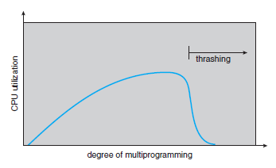
Thrashing
A process is busy with swapping pages in and out. This high paging activity is called Thrashing.
A process is in thrashing if it is spending more time on paging rather than executing.
Cause of Thrashing
If a process does not have “enough” pages, the page-fault rate is very high. This leads to:
low CPU utilization.
operating system thinks that it needs to increase the degree of multiprogramming.
another process added to the system.

Slide 107
Demand Paging and Thrashing
Why does demand paging work?
To prevent thrashing, we must provide a process with as many frames as it needs.
But how do we know how many frames it “needs”?
Locality model - working-set strategy starts by looking at how many frames a process is actually using. This approach defines the locality model of process execution

Slide 108
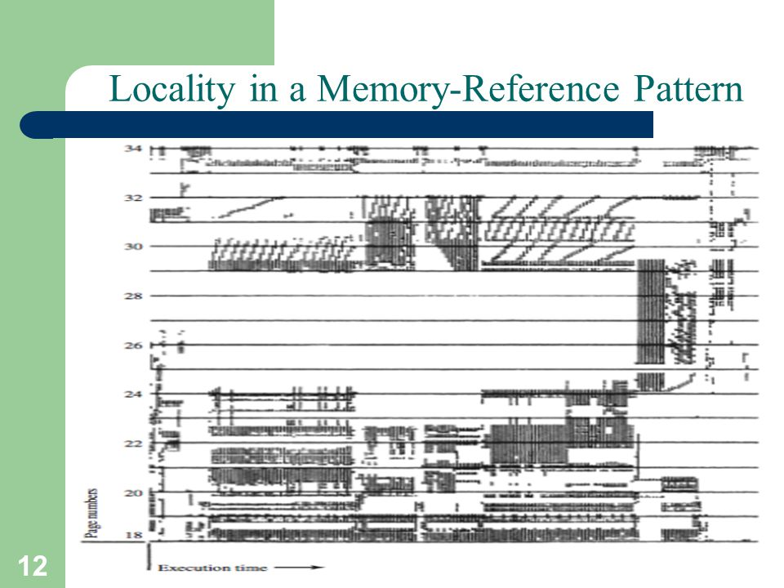
Demand Paging and Thrashing - Contd
Process migrates from one locality to another (Figure)
Localities may overlap
Example:
Function is called, that defines a new locality.
In this, memory references are made to the instructions of the function call, its local variables, and a subset of the global variables. When we exit the function, the process leaves this locality, since the local variables and instructions of the function are no longer in active use.

Slide 109
Demand Paging and Thrashing – Cont.
Why does thrashing occur?
Σ size of locality > total memory size
Limit effects by using local or priority page replacement
Local replacement algorithms - if one process starts thrashing it cannot steal frames from another process and cause thrashing latter.
However if processes are thrashing, they will be in the queue for the paging device most of the time.
The average service time for a page fault will increase, due to the longer queue for the paging device.
Thus the effective access time will increase even for a process that is not thrashing.

Slide 110
Models to Avoid Thrashing
There are 2 Models to Avoid Thrashing
Working – set Model
Works based on Locality of Reference
Page Fault Frequency Model
Based on Upper and Lower Page Fault Rate

Slide 111
Working Set Model
It is based on the assumption of locality.
Δ ≡ working-set window ≡ a fixed number of page references Example: 10,000 instruction
The idea is to examine the most recent Δ page references.
WSS_{i} (working set of Process Pi) = total number of pages referenced in the most recent Δ (varies in time)
if Δ too small will not encompass entire locality.
if Δ too large will encompass several localities.
if Δ = ∞ ⇒ will encompass entire program.
D = Σ WSS_{i} ≡ total demand frames
if D > m ⇒ Thrashing
Policy if D > m, then suspend one of the processes.
if D <= m ⇒ No Thrashing

Slide 112
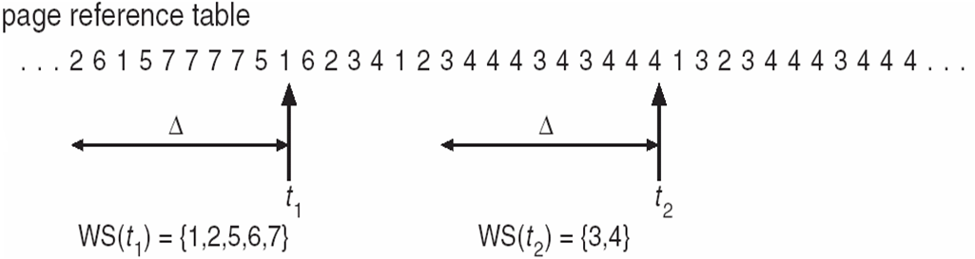
Working Set Model – Contd.
The sequence of memory references shown in Figure,
if Δ = 10 memory references,
Then the working set at time
t1 is {1, 2, 5, 6, 7}
t2, the working set has changed to {3, 4}.
The working set model states that a process can be in RAM if and only if all of the pages that it is currently using (often approximated by the most recently used pages) can be in RAM.

Slide 113
Keeping Track of the Working Set
The working set prevents thrashing while keeping the degree of multiprogramming as high as possible, in order to optimize the CPU utilization.
Difficulty: keeping track of the working set
Approximate with interval timer + a reference bit
Example: Δ = 10,000
Timer interrupts after every 5000 time units.
Keep in memory 2 bits for each page.
Whenever a timer interrupts copy and sets the values of all reference bits to 0.
If one of the bits in memory = 1 ⇒ page in working set.
Why is this not completely accurate?
Improvement = 10 bits and interrupt every 1000 time units.

Slide 114
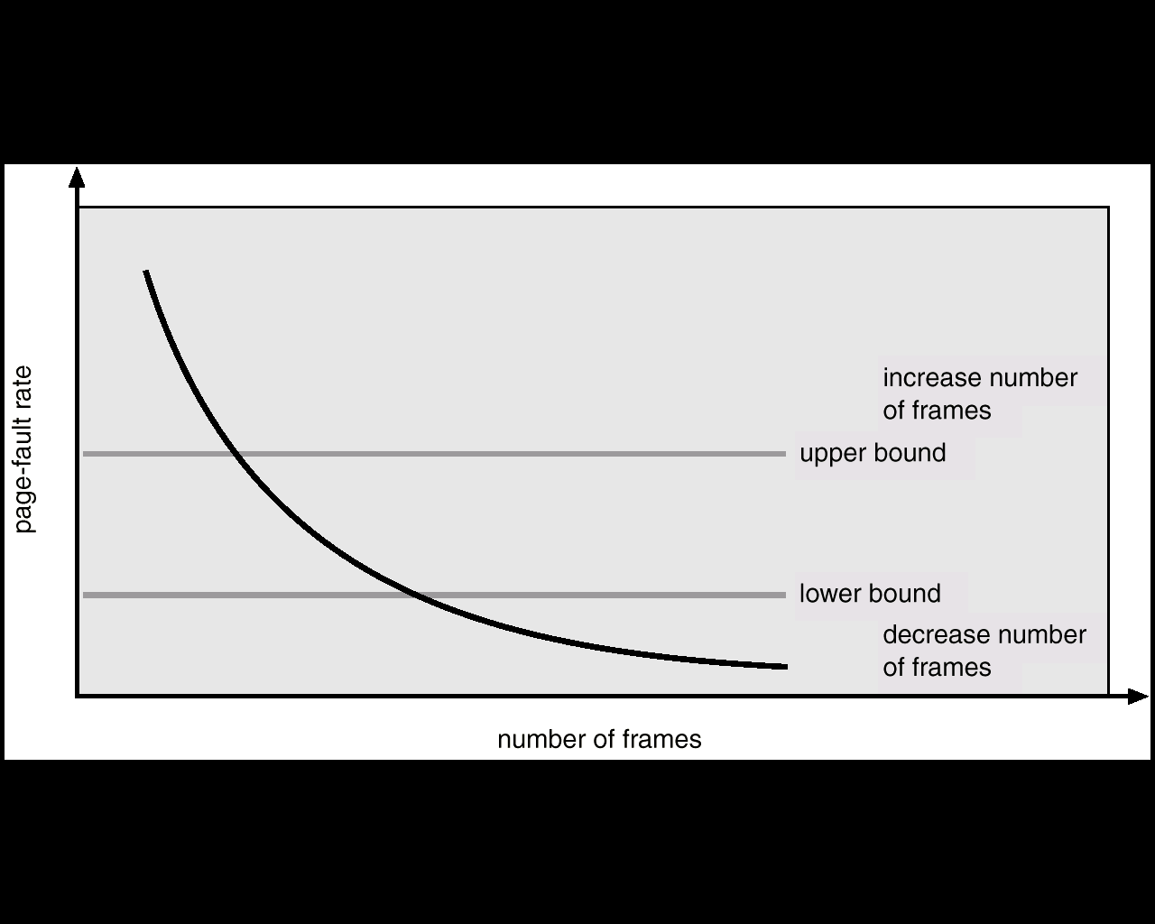
Page-Fault Frequency
More direct approach than Working Set model.
Where working set seems a clumsy way to control thrashing.
If page fault rate is too high, then the process need more frames.
Whereas page fault is too low, then the process may have too many frames.
Establish “acceptable” page-fault frequency (PFF) rate and use local replacement policy
If actual rate too low, process loses frame
If actual rate too high, process gains frame

Slide 115
Page-Fault Frequency – Contd.
As with the working-set strategy, we may have to swap out a process.
If the page-fault rate increases and no free frames are available, we must select some process and swap it out to backing store.
The freed frames are then distributed to processes with high page-fault rates

